Slide 1
Causes of Death Analysis
Yafreisi Basilio, Zohna Jones, Aizel Magsino, Angelica Vizcaino

Slide 2
Background
Scientists are constantly trying to find out what factors leads to death whether it be behavioral, environmental, or financial.
Goal: Analyze the relationship between tobacco use, obesity, and income on the number of deaths per state and on a national level
Hypothesis: Obesity, Tobacco, and income are all positively correlated factors to number of deaths
Variables for Exploration: Tobacco Use %, Obesity %, Per Capita Income, Number of Deaths
Notes:
Aizel

Slide 3
Sources
Leading Causes of Death (for death rates): https://www.cdc.gov/nchs/data-visualization/mortality-leading-causes/index_2.htm
Factors Tobacco Use (tobacco percentage): https://www.americashealthrankings.org/explore/annual/measure/Smoking/
Alcohol (consumption by alcohol): https://pubs.niaaa.nih.gov/publications/surveillance110/tab4-1_16.htm
Obesity (obesity rate percentage): https://chronicdata.cdc.gov/Nutrition-Physical-Activity-and-Obesity/Nutrition-Physical-Activity-and-Obesity-Behavioral/hn4x-zwk7/data
Personal Income by state: https://apps.bea.gov/itable/iTable.cfm?ReqID=70&step=1
Notes: Mortality and causal links to behavioral factors: https://www.cdc.gov/mmwr/preview/mmwrhtml/su6304a2.htm#tab3
Alcohol consumption (national, state, regional): https://pubs.niaaa.nih.gov/publications/surveillance110/CONS16.htm#top https://www.niaaa.nih.gov/publications/brochures-and-fact-sheets/alcohol-facts-and-statistics#:~:text=
Age Adjusted Death Rate: https://www.health.ny.gov/diseases/chronic/ageadj.htm https://health.mo.gov/data/mica/CDP_MICA/AARate.html
Notes:
aizel

Slide 4
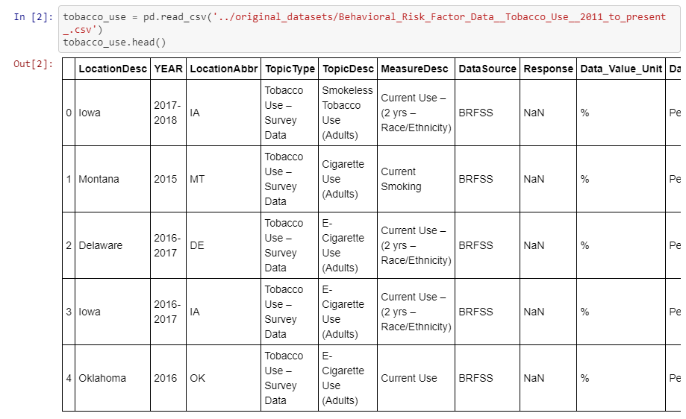
Cleaning/Database Process
Extracting raw data csv files and importing to jupyter notebook using pandas to transform the data. We selected 3 columns from each of the 6 datasets to use in our final dataset for this project.
Notes:
Angelica

Slide 5
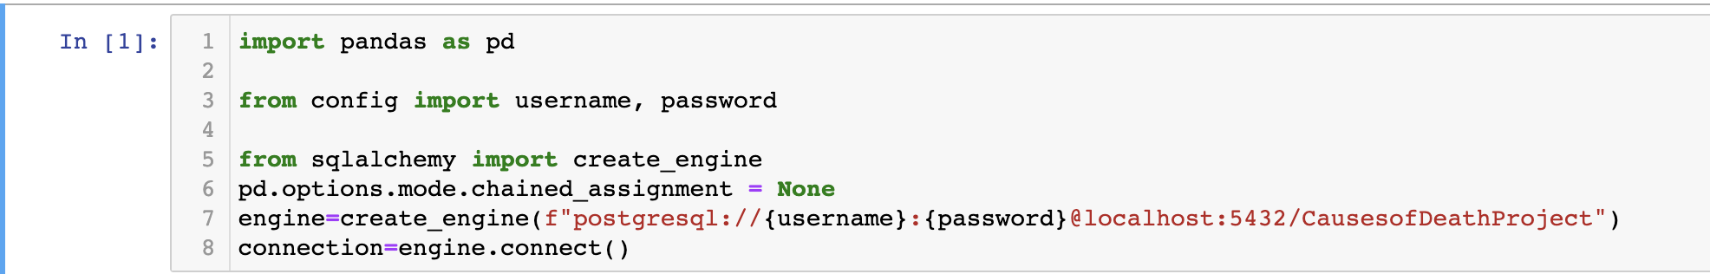
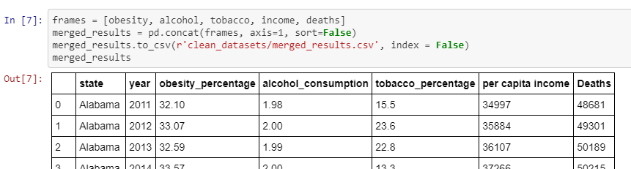
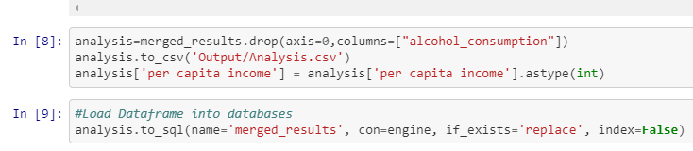
Cleaning/Database Process
Once the datasets were transformed, we merged all datasets and load them to the PostgreSQL Database
Notes:
Angelica

Slide 6
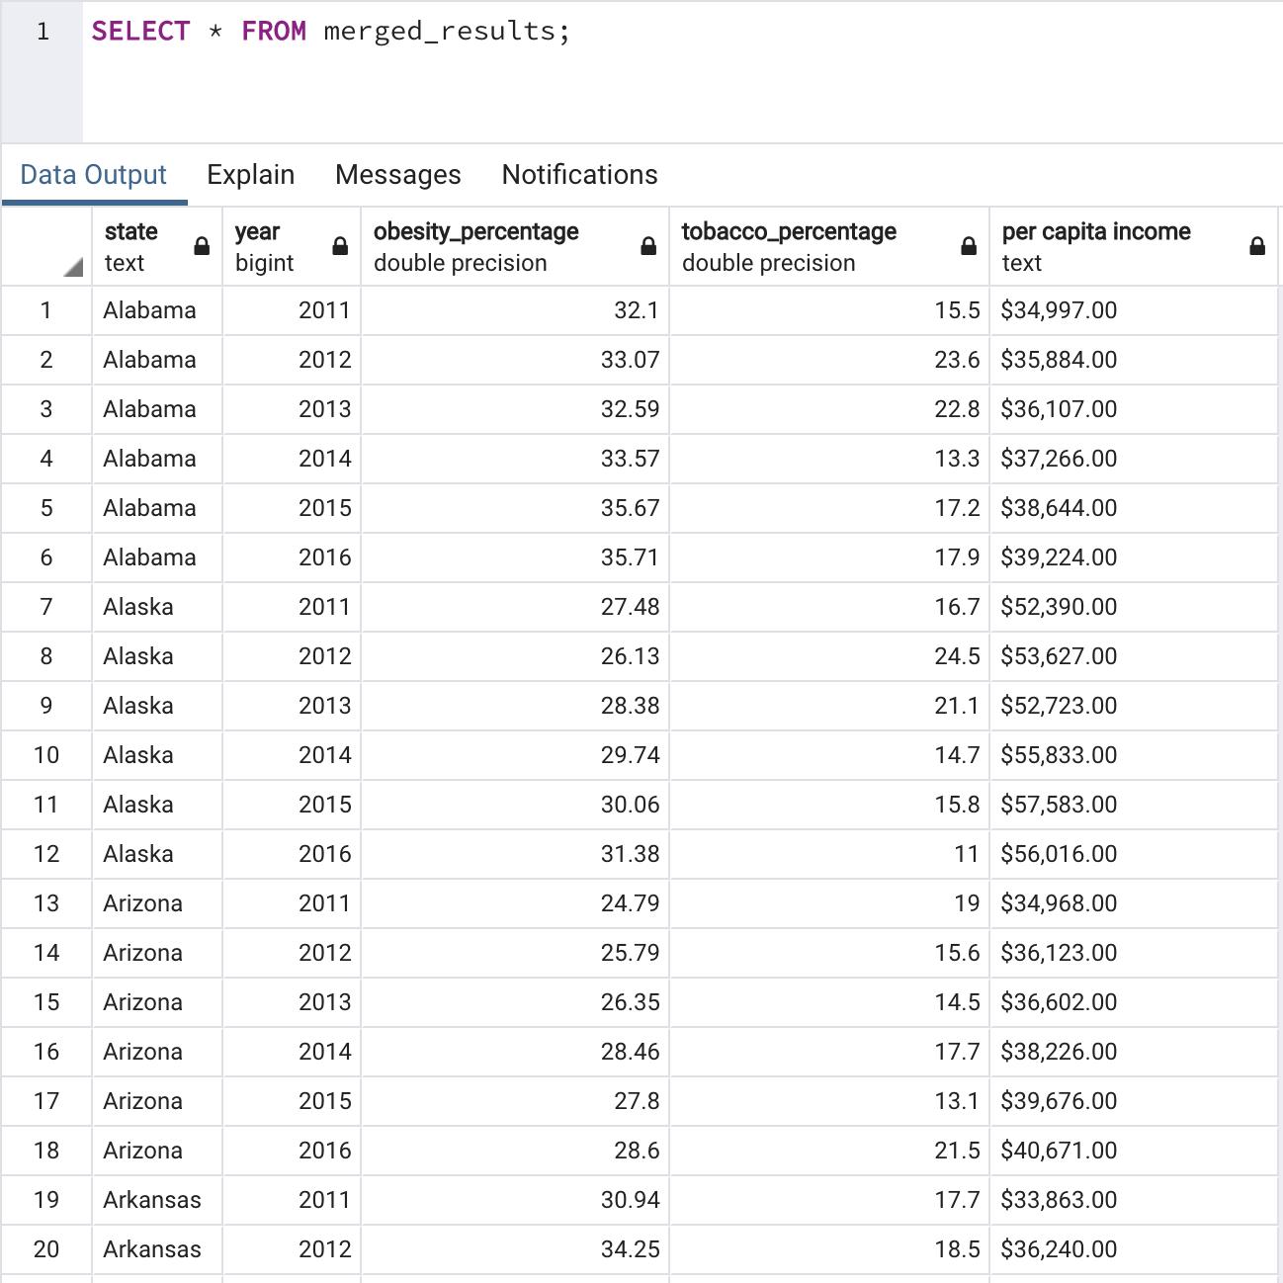
Database
PostgreSql
Notes:
Angelica

Slide 7
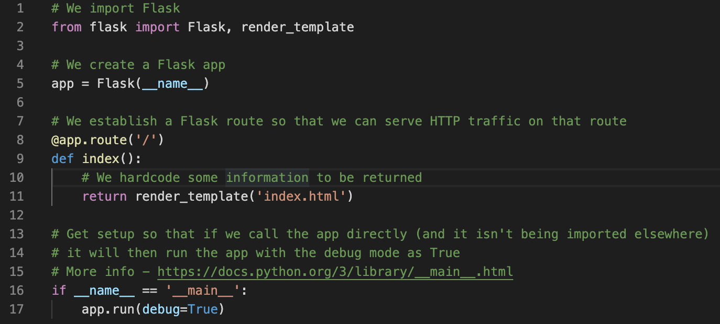
Flask
Notes:
Zohna-
Used flask to render our index.html template
Major problems with this as we were first confused about the use of flash (spent like 3 days on this)
If more time would’ve added more routes to store data

Slide 8
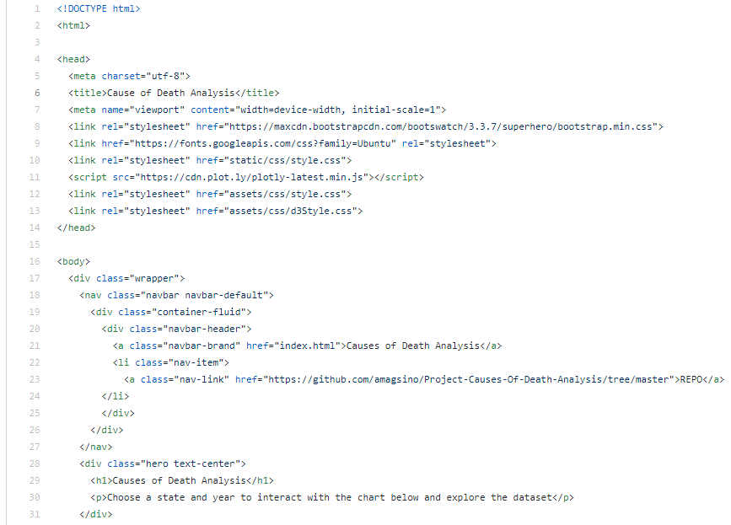
HTML
Challenges we found doing the index was adding multiple visualizations, adding spaces, differentiating class ids
Notes:
Aizel

Slide 9
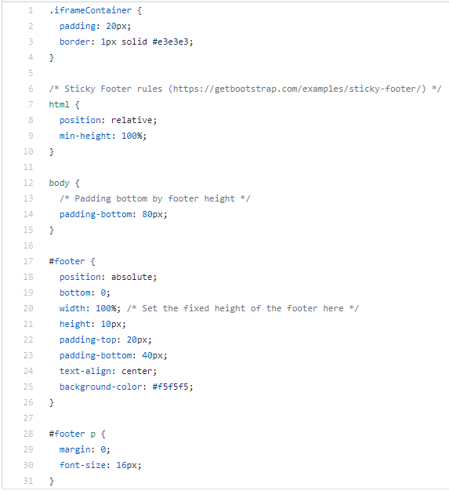
CSS
Notes:
Used multiple Css
Helped developed style of dashboard
Yafreisi

Slide 10
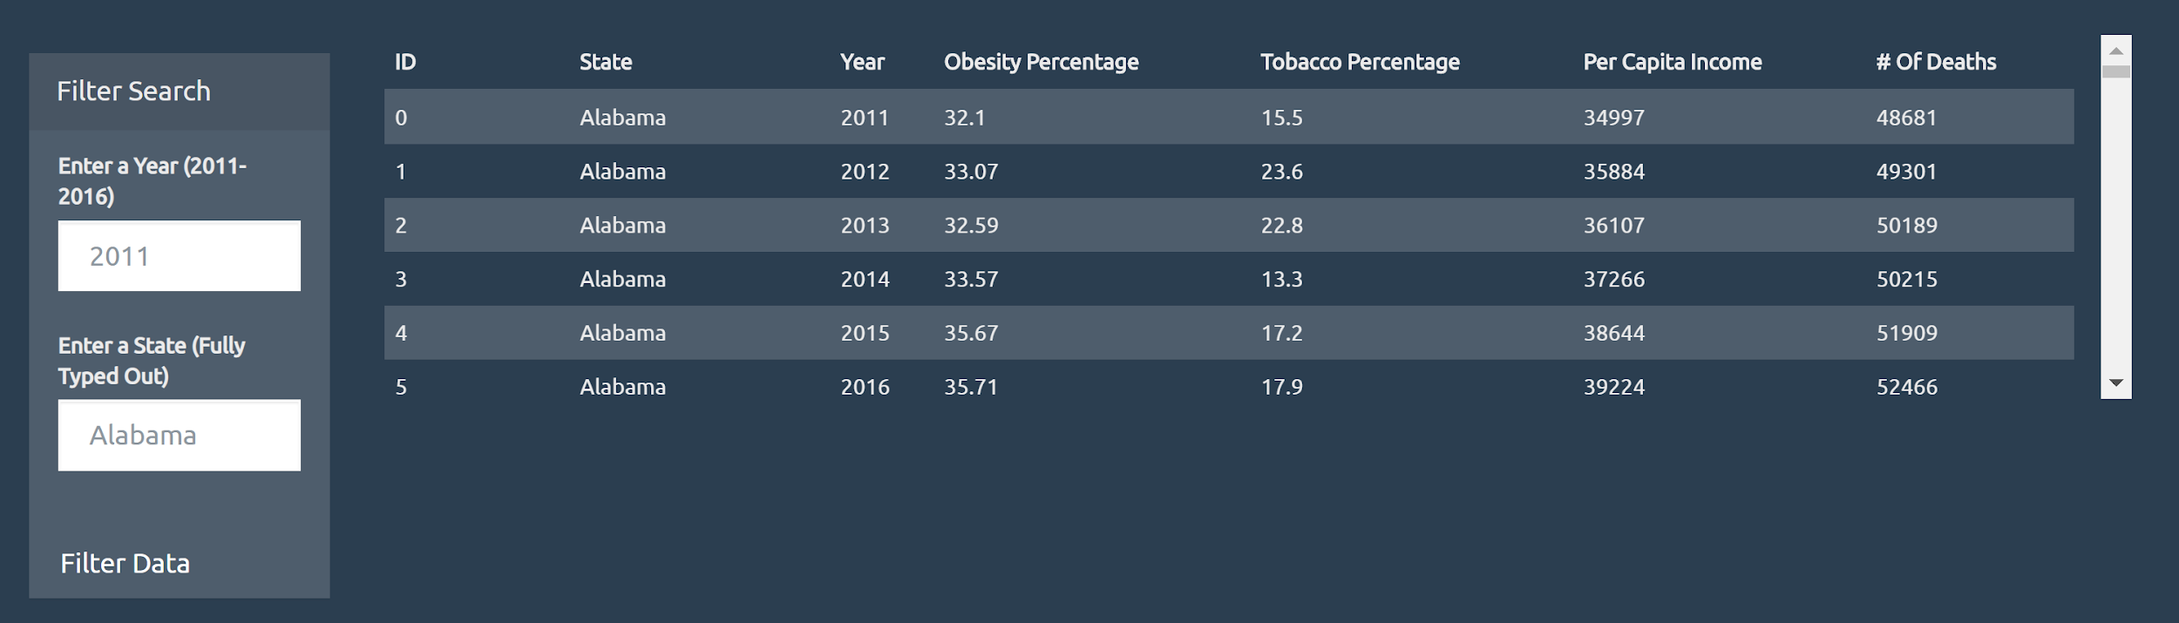
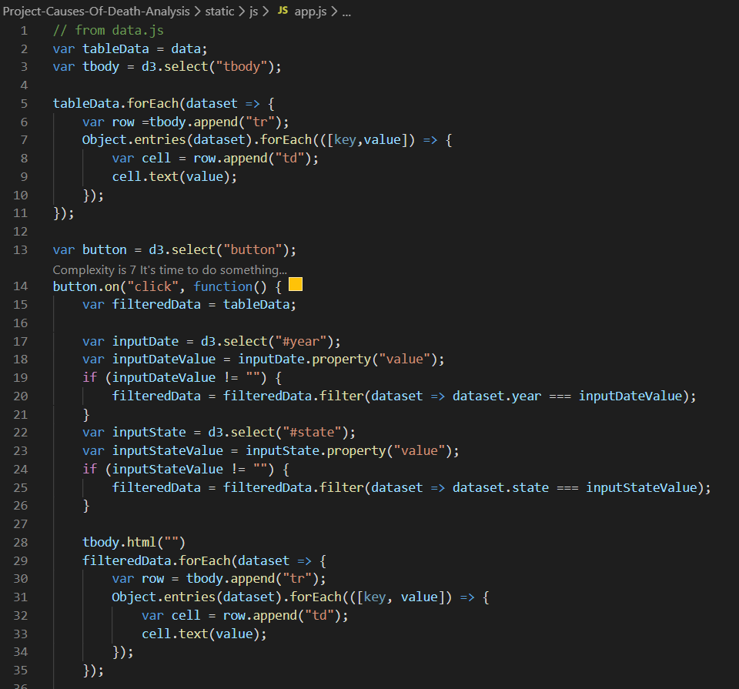
Visualizations
Notes:
Yafreisi
Filtered search data (app.js)
Incorporated D3 Tooltips in line graph (will see when go to site)

Slide 11
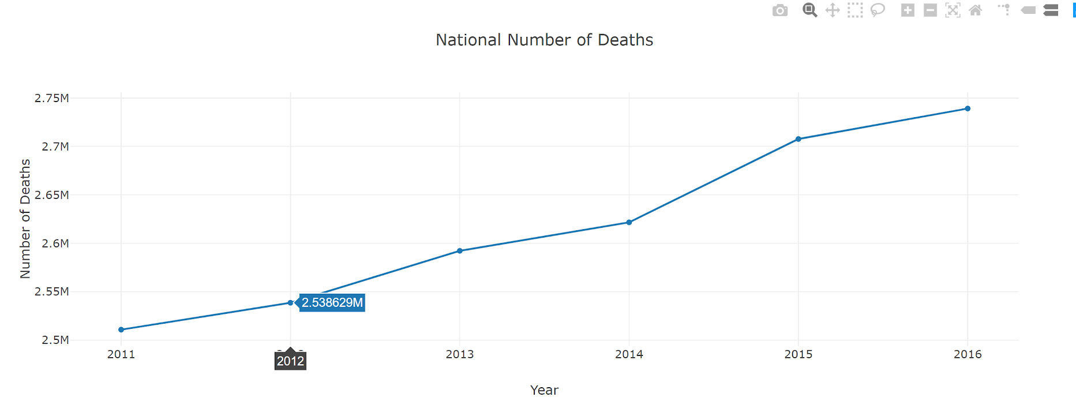
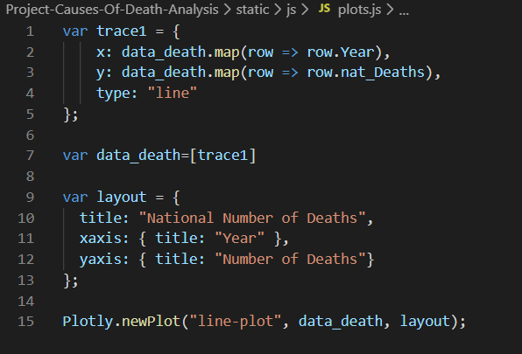
Visualizations Continued
Notes:
Yafreisi
National Number of Deaths
Incorporated D3 Tooltips in line graph (will see when go to site)

Slide 12
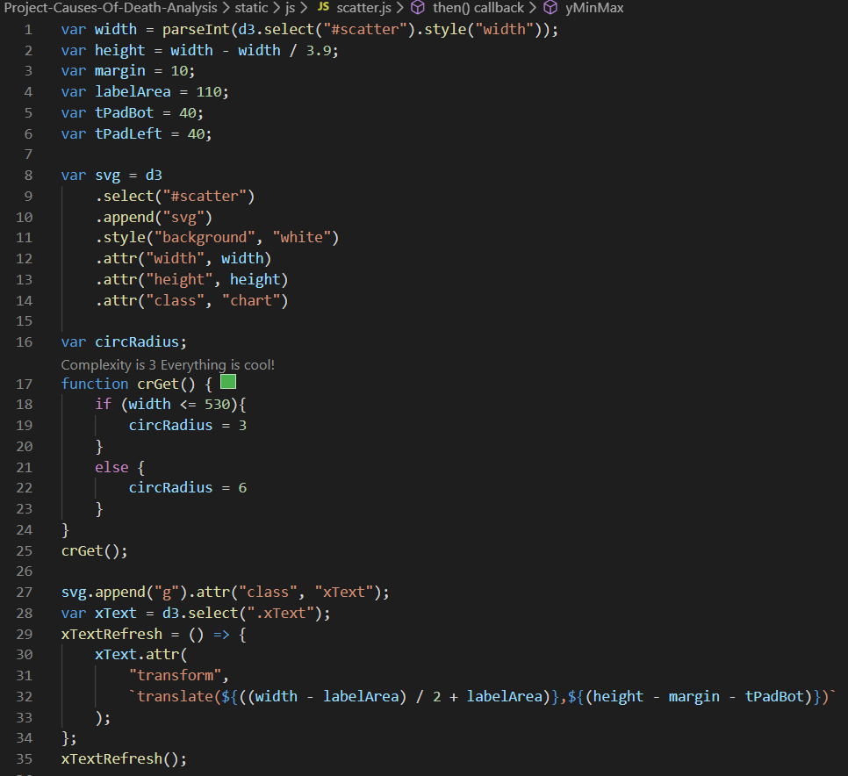
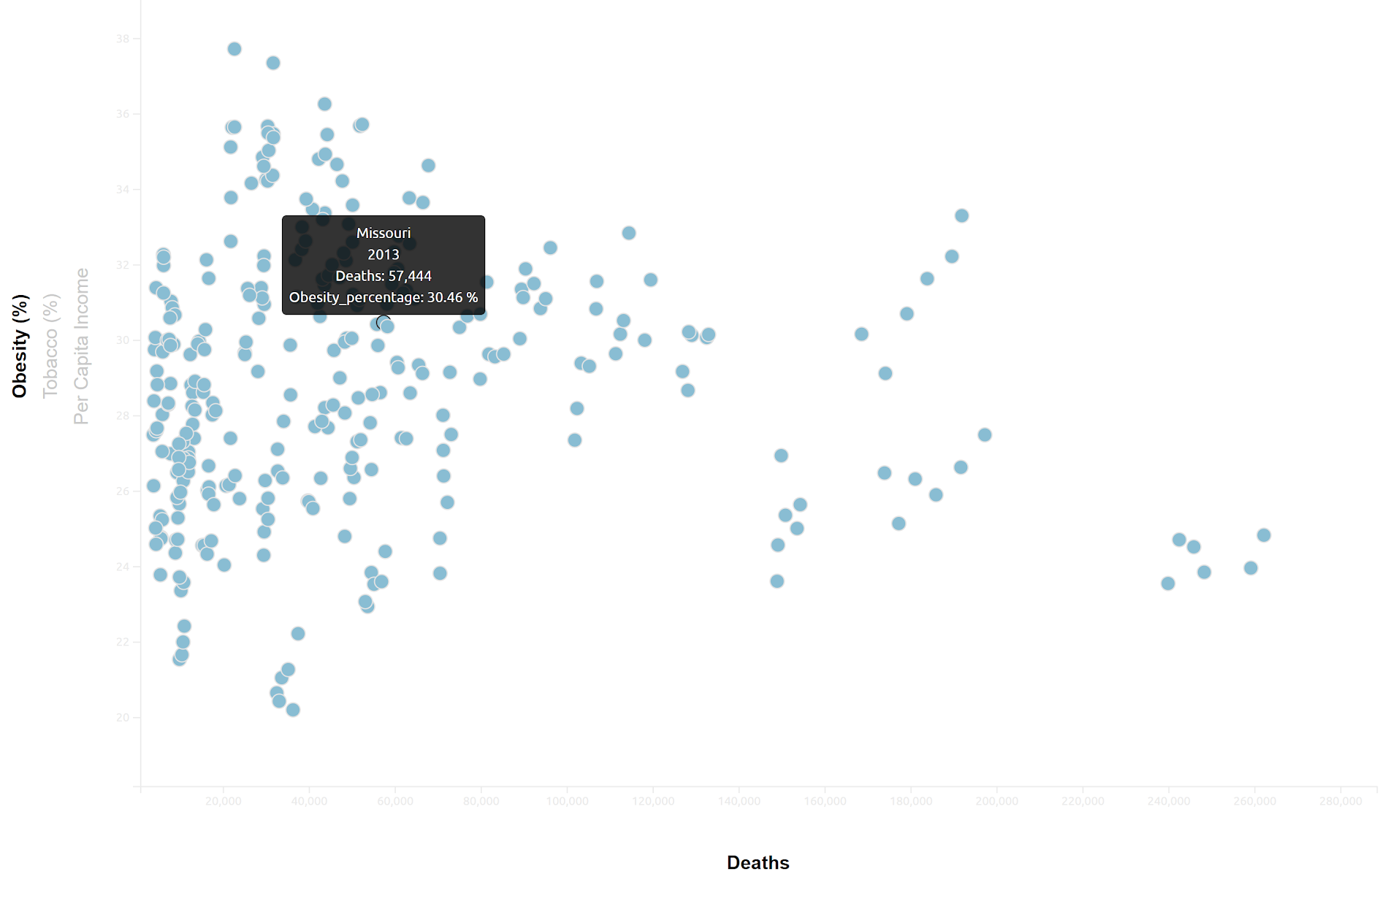
Visualizations Continued
Notes:
D3 tooltips for scatter
Matplotlib examining variables according to year

Slide 13
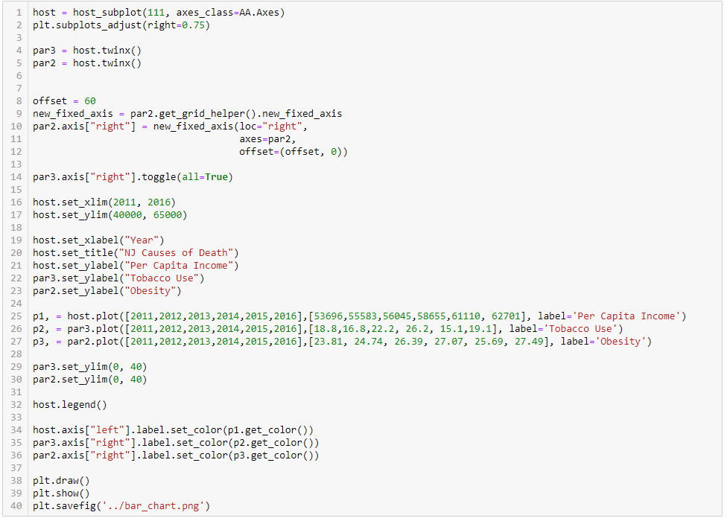
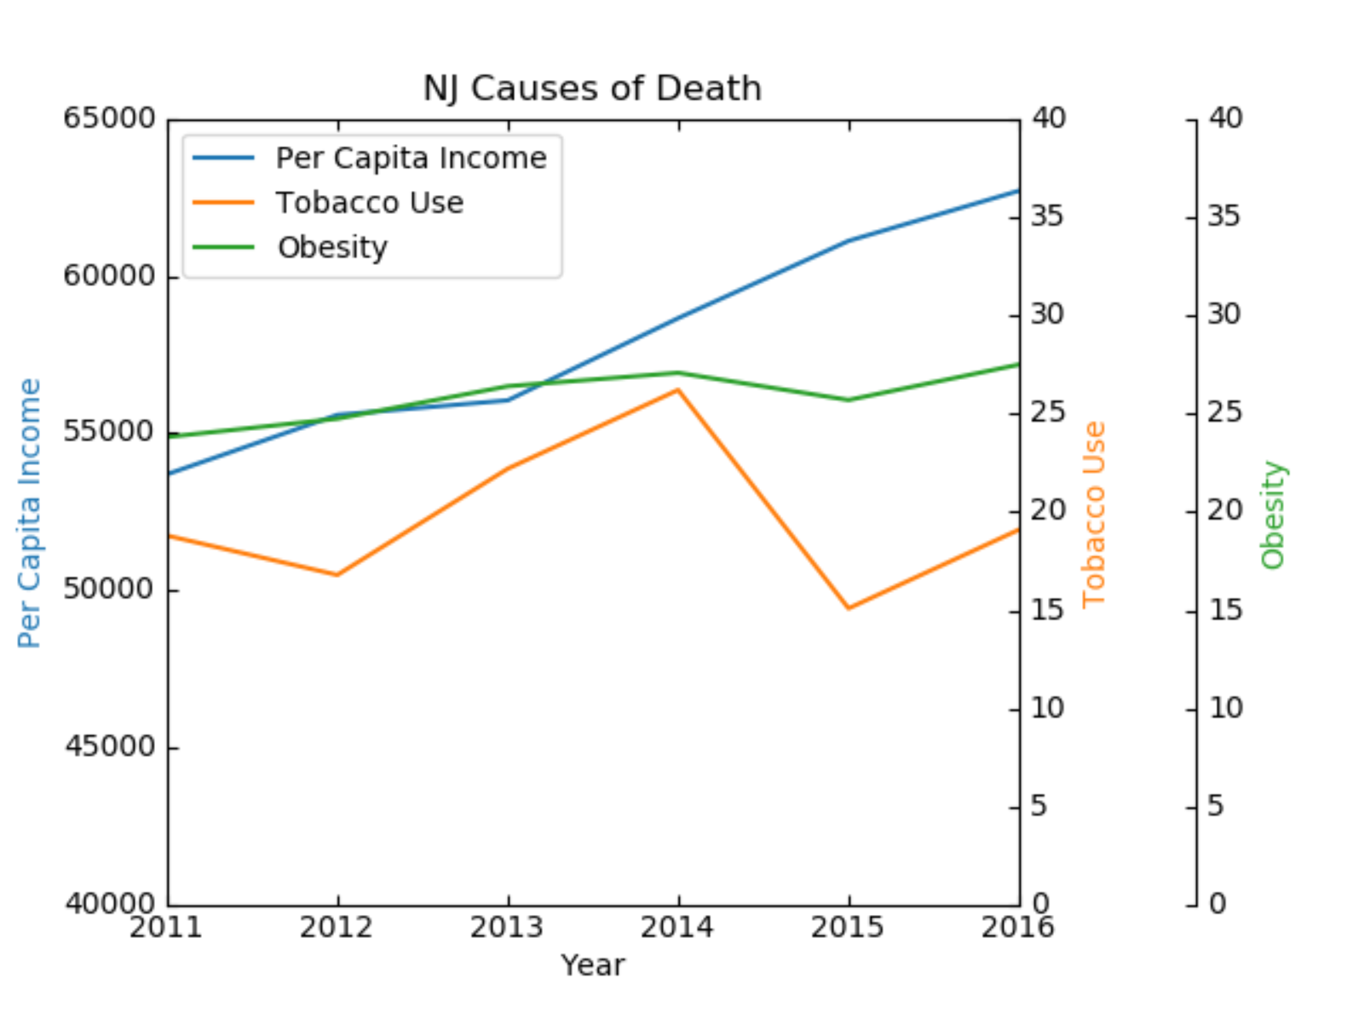
Visualizations Continued
Notes:
D3 tooltips for scatter
Matplotlib examining variables according to year

Slide 14
Trends
None of the variables explored contribute alone to the number of deaths
Most of the states per capita income for all years shows that although income increases slightly, deaths are only slightly increasing
Relative to each state, obesity rates don’t change significantly per year
Number of deaths nationally increase every year
Notes:
Zohna

Slide 15
What Worked/What Didn’t Work
What Didn’t Work:
Scope of our project was too big at first
Too many variables
Too broad
Constantly had to adjust timeline
Dropdown/Filter
Visualization Issues
Connecting filtered chart to d3 scatter
What Worked:
Flask (after many days and figuring out)
D3 (after many attempts)
The Index
Notes:
Aizel

Slide 16
Final Comments
Great Learning experience, for the future we would narrow down more variables, focus more on the visualizations.
With More time: We considered adding dropdowns that enable the user to select and filter out the graphs as well as another js library.
Notes:
Zohna

